Slide 1
Bagh Bandi
Name : Mahdee Hasan
Roll : BSSE 1010
Supervisor: Md. Saeed Siddik

Slide 2
Bagh Bandi
Bagh bandi is a two-player abstract strategy board game. It is also a tiger hunt game .
The game originates from Lower Bengal, India.

Slide 3
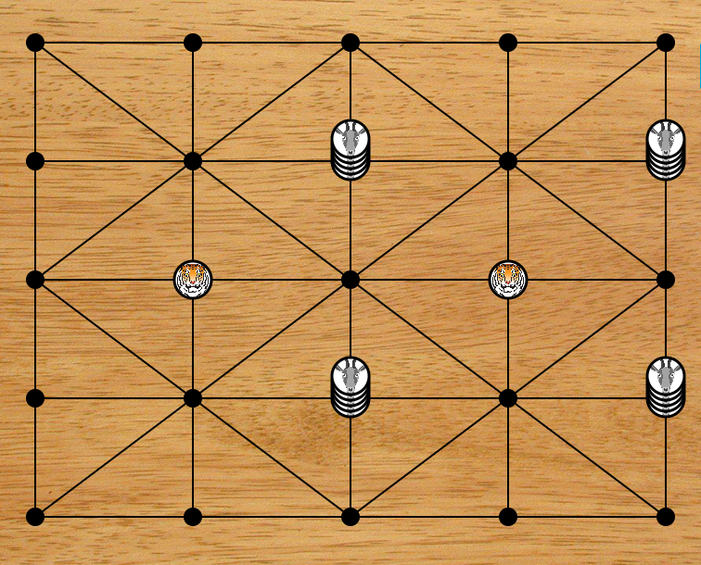
Alquerque Board
Opening Position

Slide 4
Objective
The goats win if they blockade the tigers in so that they are unable to make a legal move.
The tigers win if they manage to capture all of the goats, or enough (more than 15) of them to make their objective impossible.
The blockade tiger and captured goat counter is removed from the board for the rest of the game.

Slide 5
Rules and Regulation
The game commences with the goat counters positioned as opening position.
Both of the counter may move along a line to an adjacent vacant intersection
A stack of more than one goat counter, however, may not move as a whole and the counters constituting it must be moved, one by one, on a turn.
Once leaving the stack, however, the goats may not be restacked.

Slide 6
Rules and Regulation
The goats may not jump over the tigers.
The tigers may jump over the stack of goats or a goat
beyond the line an adjacent vacant intersection once per turn and captured one goat.

Slide 7
Rules and Regulation
Capturing goats

Slide 8
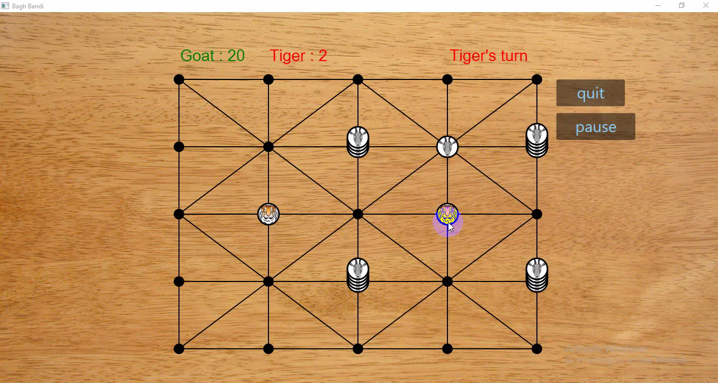

Slide 9
Rules and Regulation
Blockade tigers

Slide 10
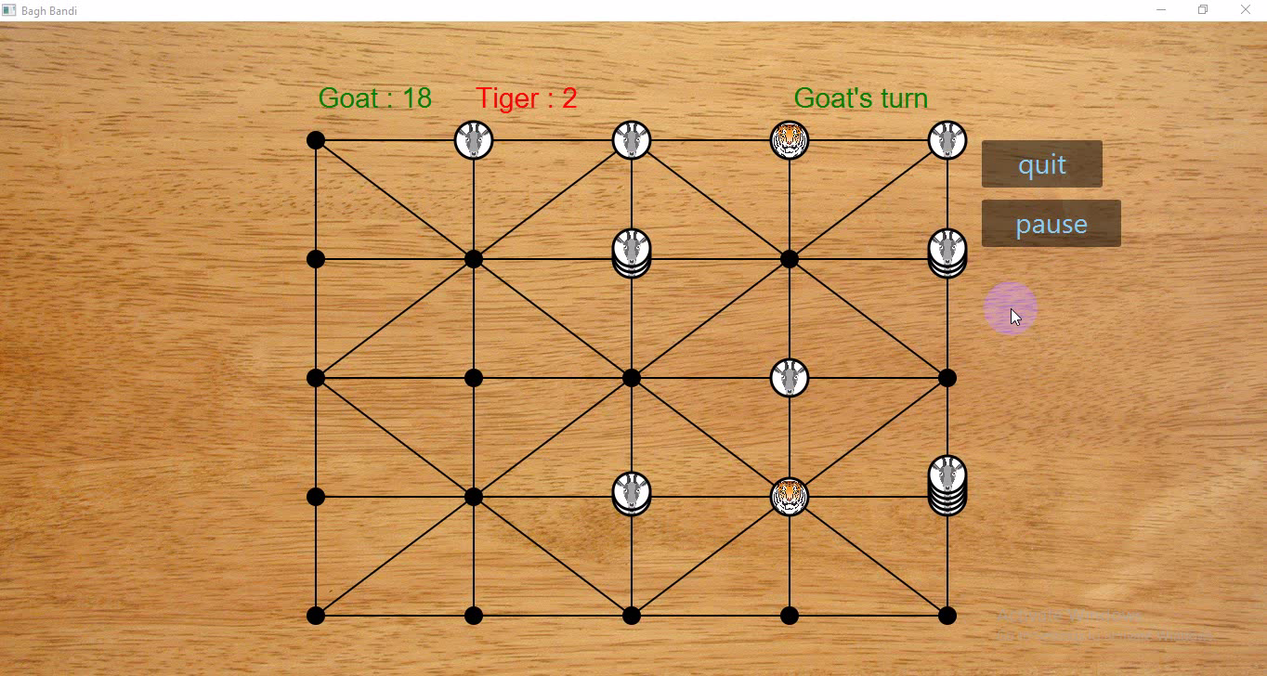

Slide 11
Task for this game
Two player computer game.(Done before midterm)
Play against computer (one player) with three difficulty level (Easy, Medium, Hard). (Done after midterm)

Slide 12
Single Player
I used optimized minimax algorithm(Alpha-Beta pruning) for making difficulty level.
I used depth of the tree as one, two and three respectively in easy, medium and hard level.

Slide 13
Alpha Beta Pruning
Alpha-Beta pruning is not actually a new algorithm, rather an optimization technique for minimax algorithm. I used this algorithm, because it reduces the computation time by a huge factor.

Slide 14
Complexity
Time complexity for the best case is O(b^(d/2)) where b = branching factor and d = depth of the tree, and the base case is when all the preferred nodes are expanded first.
In the worst case, where there is no node to be pruned, the full tree will be examined. Then the complexity for the this case is O(b^d)

Slide 15
Play against goats

Slide 16
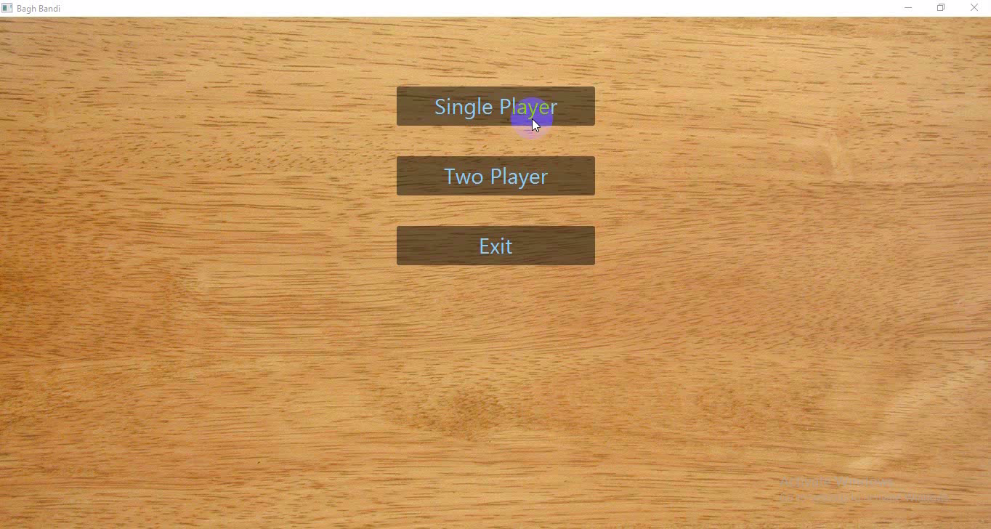

Slide 17
Play against tigers

Slide 18
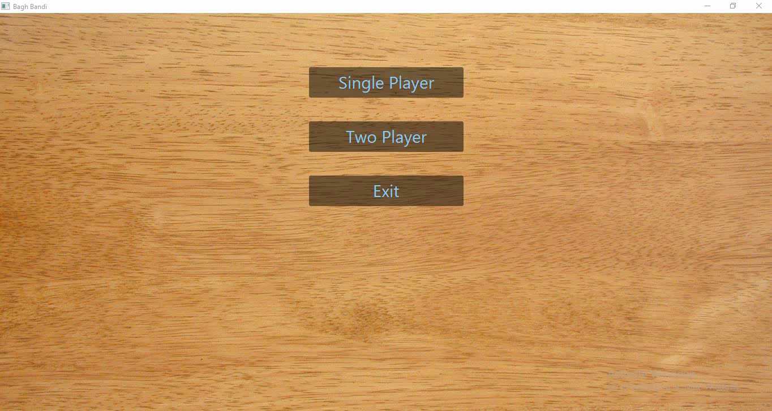

Slide 19
Project Link
My project code link is below
https://github.com/mahdeehasanbd1010/SPL-1

Slide 20
Thank you
(:

Slide 21
Minimax Algorithm
The minimax algorithm is one of the oldest artificial intelligence algorithms ever. Minimax is a kind of backtracking algorithm that is used in decision making and game theory to find the optimal move for a player, assuming that your opponent also plays optimally.

